Slide 1
Introduction to Software Engineering
Requirements Modeling – Scenario, Information and Analysis classes (2)
Muhammad Nasir
m.nasir@iiu.edu.pk

Slide 2
Agenda
Class Based Modeling
Identify Analysis Classes

Slide 3
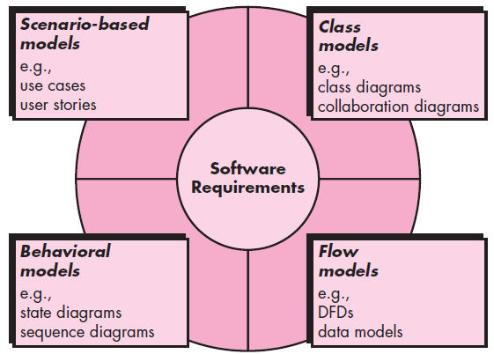
Elements of Analysis Model

Slide 4
Class Base Modeling
Class-based modeling represents the objects that the system will manipulate
The operations (also called methods or services) that will be applied to the objects to effect the manipulation
The relationships between the objects, and the collaborations that occur between the classes that are defined.

Slide 5
Identifying Analysis Classes
If you look around a room, there is a set of physical objects that can be easily identified, classified, and defined (in terms of attributes and operations).
But when you “look around” the problem space of a software application, the classes (and objects) may be more difficult to comprehend.

Slide 6
Identifying Analysis Classes
We can begin to identify classes by examining the usage scenarios developed as part of the requirements model
Classes are determined by underlining each noun or noun phrase and entering it into a simple table. Synonyms should be noted to avoid repetition.
Notes:
Some more examples of noun phrases are underlined in the sentences below. The head noun appears in bold.
The election-year politics are annoying for many people.Almost every sentence contains at least one noun phrase.
"Those five beautiful shiny Arkansas Black apples sitting on the chair" is a noun phrase of which apples is the head. To test, a single pronoun can replace the whole noun phrase, as in "They are delicious".
Current economic weakness may be a result of high energy prices.

Slide 7
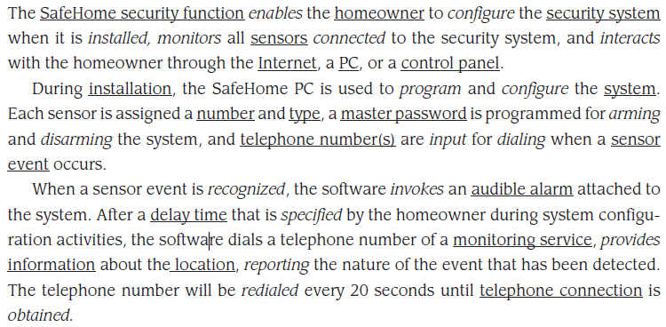
Identifying Analysis Classes

Slide 8
Guidelines for Identifying Classes
External entities (e.g., other systems, devices, people) that produce or consume information to be used by a computer-based system.
Things (e.g., reports, displays, letters, signals) that are part of the information domain for the problem.
Occurrences or events (e.g., a property transfer or the completion of a series of robot movements) that occur within the context of system operation.
Roles (e.g., manager, engineer, salesperson) played by people who interact with the system.

Slide 9
Guidelines for Identifying Classes
Organizational units (e.g., division, group, team) that are relevant to an application.
Places (e.g., manufacturing floor or loading dock) that establish the context of the problem and the overall function of the system.
Structures (e.g., sensors, four-wheeled vehicles, or computers) that define a class of objects or related classes of objects.

Slide 10
Class-Responsibility-Collaborator (CRC) Modeling
Class-responsibility-collaborator (CRC) modeling provides a simple means for identifying and organizing the classes that are relevant to system or product requirements.

Slide 11
Class-Responsibility-Collaborator (CRC) Modeling
A CRC model is really a collection of standard index cards that represent classes.
The cards are divided into three sections. Along the top of the card you write the name of the class.
In the body of the card you list the class responsibilities on the left and the collaborators on the right.

Slide 12
CRC – Home Owner Class
HomeOwner
Monitor_Security_Zone | Sensor
Check_Status_of_Sensor | Camera
Activate_System
Disarm_System

Slide 13
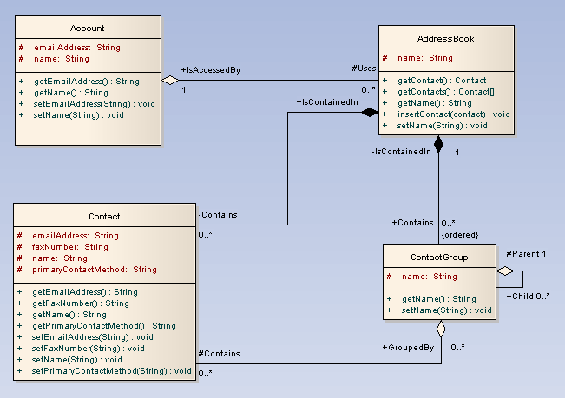
Class Diagram

Slide 14
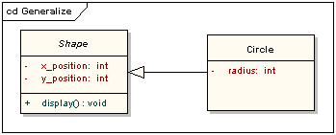
Generalization (Inheritance)

Slide 15
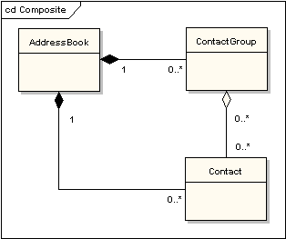
Aggregation (Composition)

Slide 16
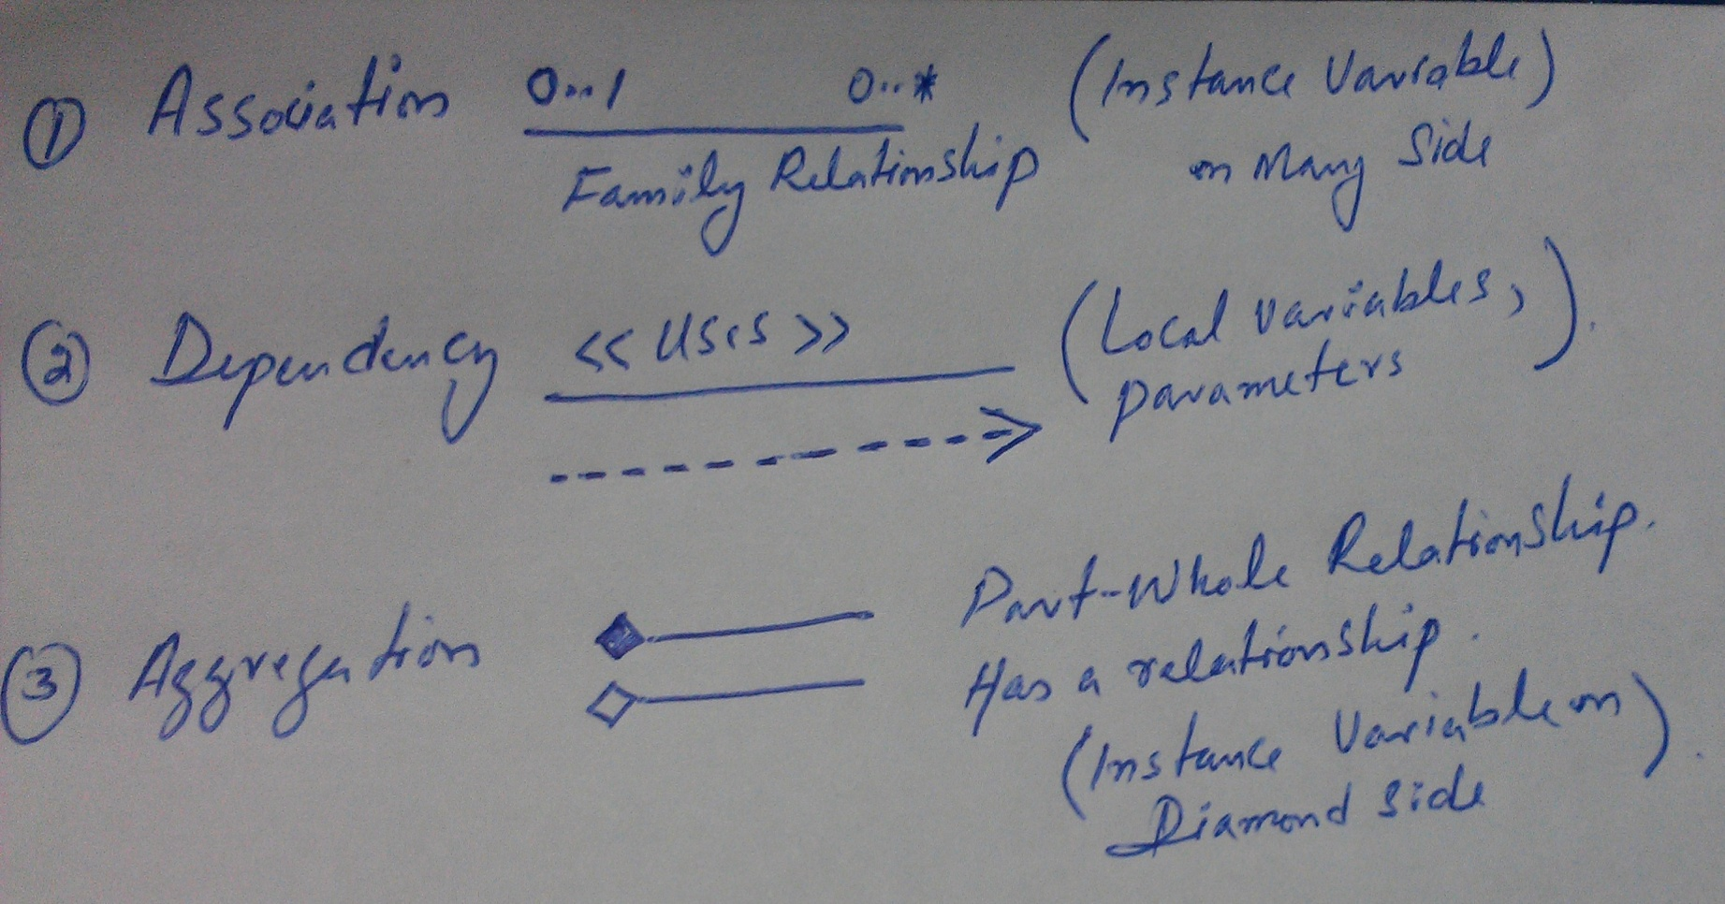
Types of Aggregation (Composition)

Slide 17
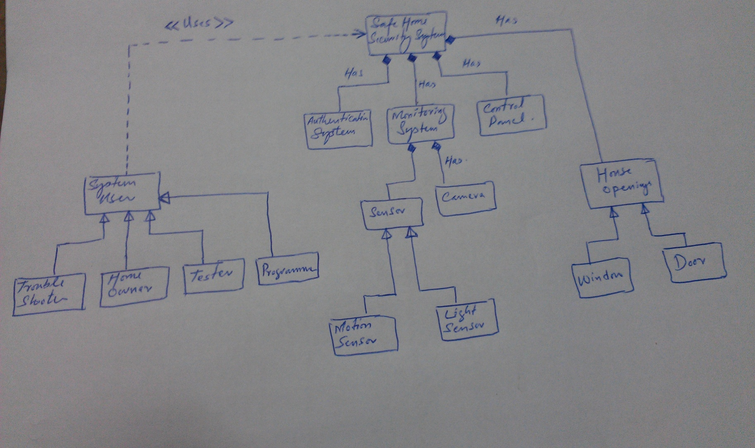
Safe Home Security System

Slide 18
The End
Thanks for listening
Questions would be appreciated.

